Slide 1
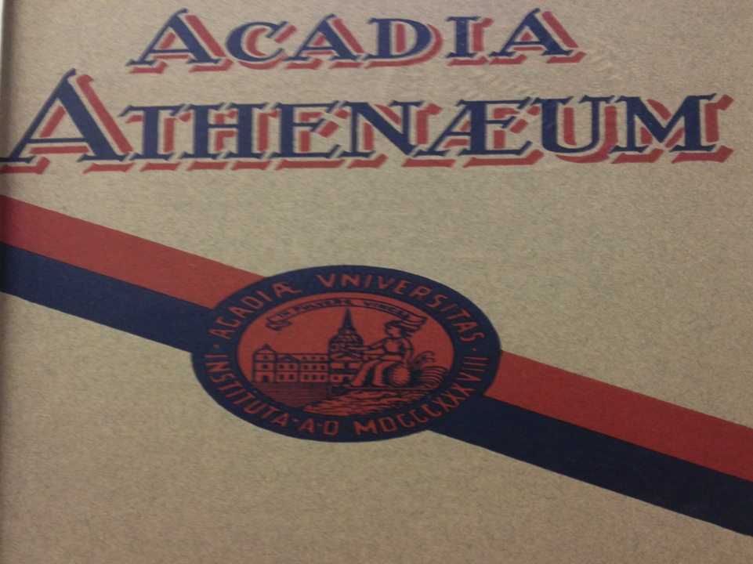
Fostering
a Wartime
Campus Discourse
1914 – 1918

Slide 2
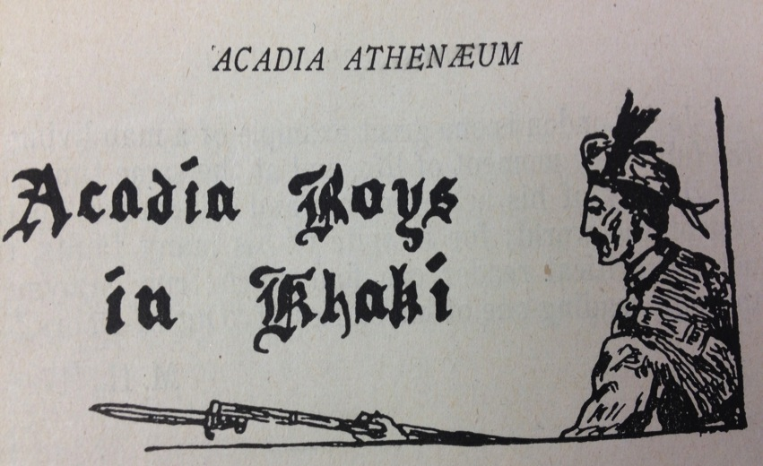
Fostering a Wartime Campus Discourse
Notes:
“Acadia Boys in Khaki” – a common feature in the Athenaeum

Slide 3
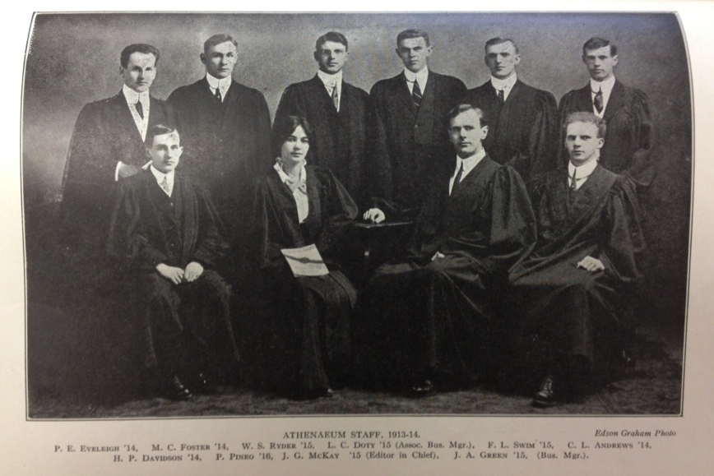
Athenaeum Staff – 1913-1914
Notes:
1 woman

Slide 4
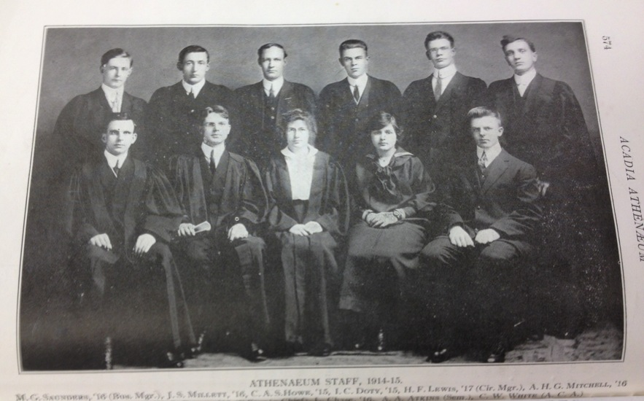
Athenaeum Staff – 1914-1915
Notes:
2 women

Slide 5
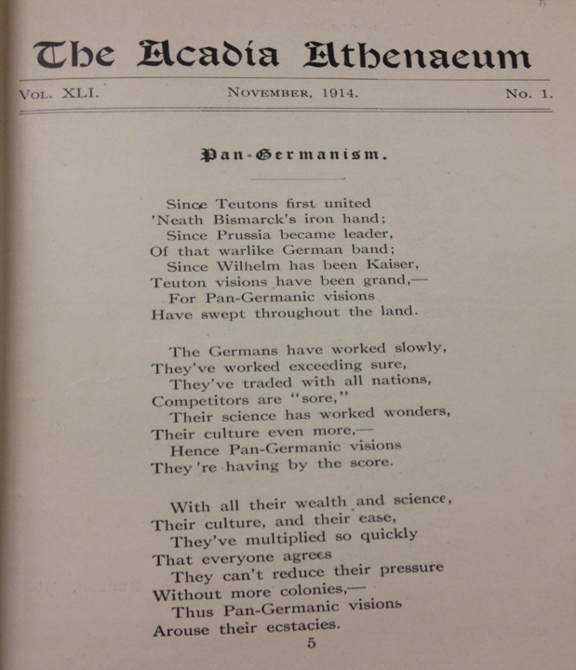
Notes:
November 1914: This poem excerpt displays the common imperialist sentiment throughout the British Empire at the outset of war. The anti-German attitudes of the author are rather clear in this text. As this passionate piece suggests, nationalistic fervour was rife amongst the Acadia student populace in the early months of the Great War.

Slide 6
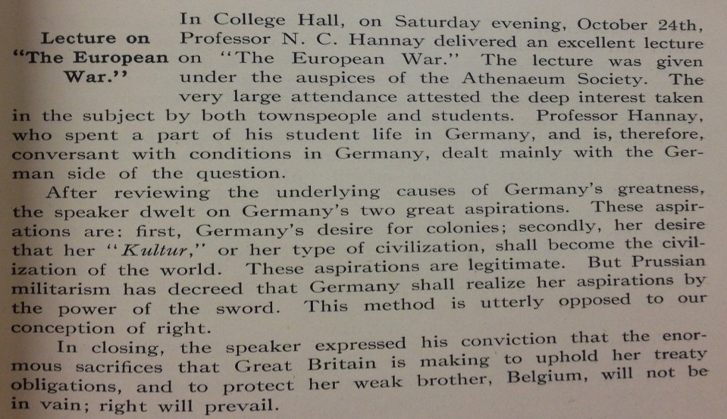
“The European War”
Notes:
November 1914: The war was referred to as “The European War” in its early stages. Until word of the true extent of violence and destruction began to travel back to Canada, students and citizens in general just figured the conflict was another European skirmish. By early 1915, however, stories in the Athenaeum would begin to refer to it as “The Great War.” The name would stick, at least, until the Second World War.

Slide 7
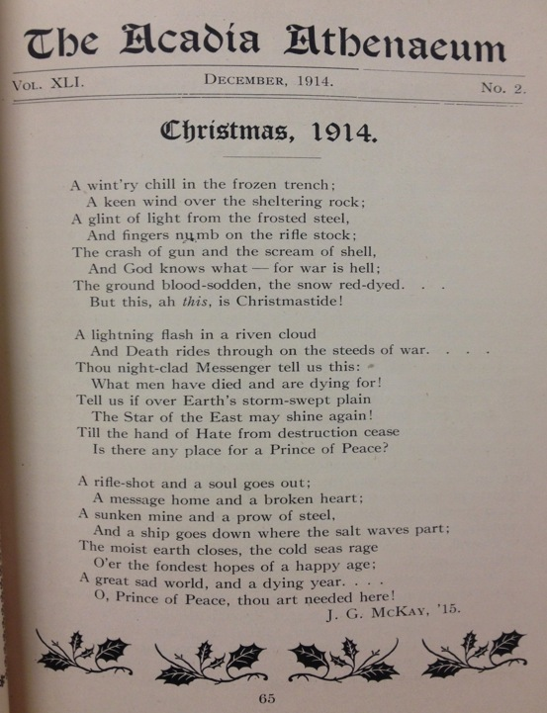
Notes:
December 1914: J. G. McKay’s Christmas poem paints a bleak picture of life at Western Front. The author writes of a “wint’ry chill in the frozen trench,” with his “fingers numb on the rifle stock.” He laments about how “war is hell.” Evidently, the festive spirit has little meaning and purpose in such an environment.

Slide 8
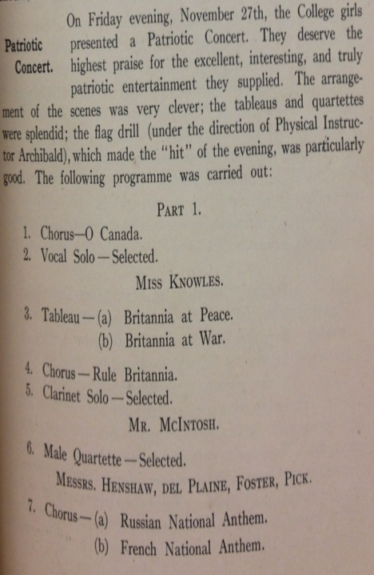
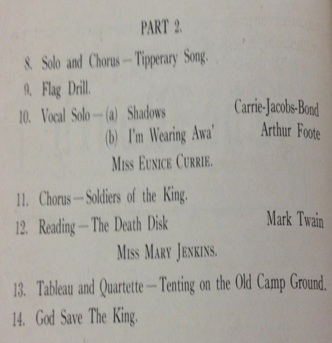
“Patriotic Concert”: Women organize recital for war effort
Notes:
December 1914: This article describes the proceedings of a Patriotic concert organized for the war effort on November 27, 1914. The programme listing includes imperial standards such as “It’s a long, long way to Tipperary” and “God Save the King.” It is interesting that the performance included both the Russian and French National Anthems. These two nations, of course, were British allies in the First World War. Thus, these tributes to their foreign collaborators are understandable if not expected.

Slide 9
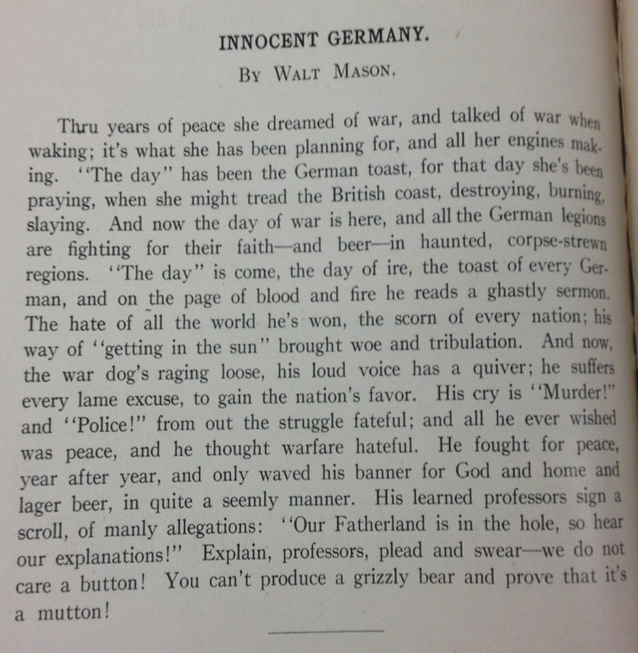
Notes:
December 1914: Walt Mason’s poem draws on that same sense of British nationalism as “Pan-Germanism,” which was published just one month prior. It expresses the way the Allies demonized their German enemy during the war. In one of his more poignant lines, Mason writes: “‘The day’ has been the German toast, for that day she’s been praying, when she might tread the British coast, destroying, burning, slaying.” The perception of the Germans as ruthless savages is evident here.

Slide 10
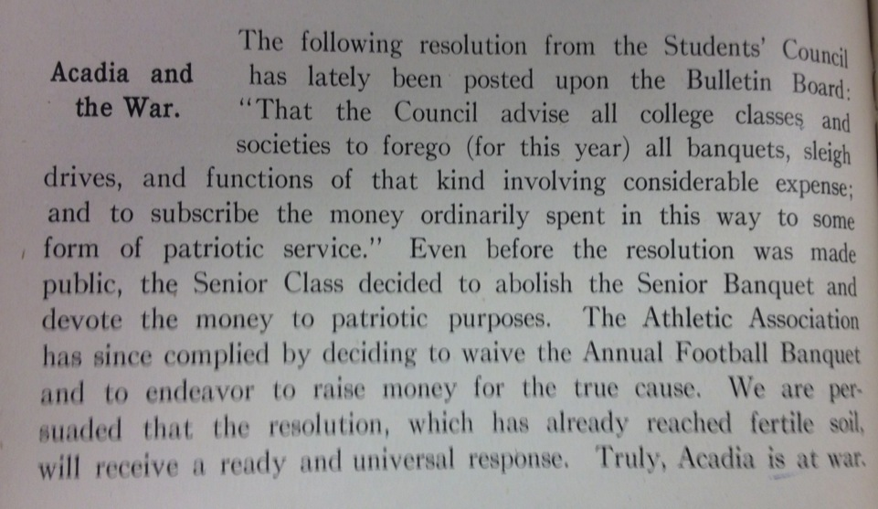
“Truly, Acadia is at War”
Notes:
December 1914: Students agree to “forego all banquets” and other festivities. Instead of spending money for entertainment purposes, students seek to “devote the money to patriotic services.” This is a characteristic of the concept of “total war,” in which virtually all aspects of society are mobilized to support the war effort.

Slide 11
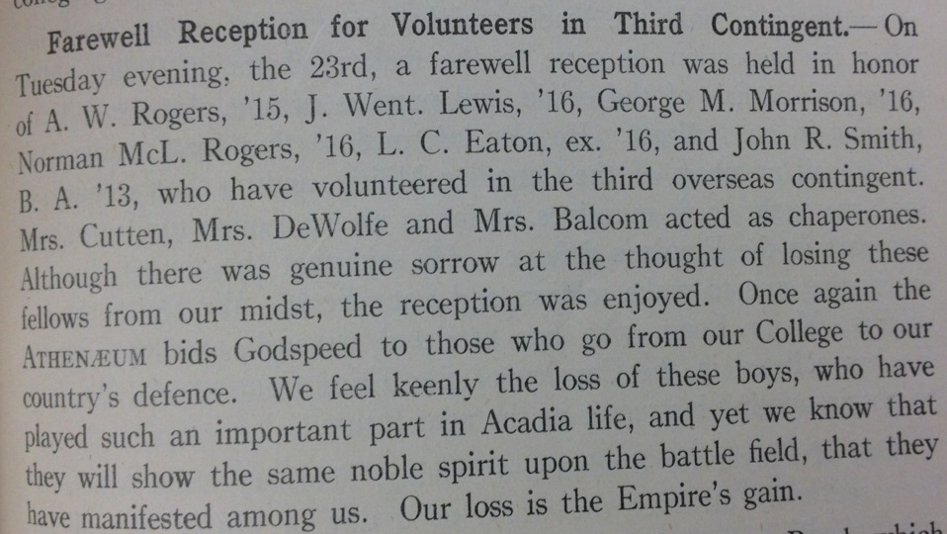
“Our Loss is the Empire’s Gain”
Notes:
March 1915: This article reports on a Farewell Reception held for students who had volunteered to fight overseas. Though saddened by “the loss of these boys,” the Athenaeum staff concludes that it is for a just cause. In times of war, academics become secondary to serving the Empire. The newspaper staff could not be more proud of its peers: “We know that they will show the same noble spirit upon the battle field, that they have manifested among us.”

Slide 12
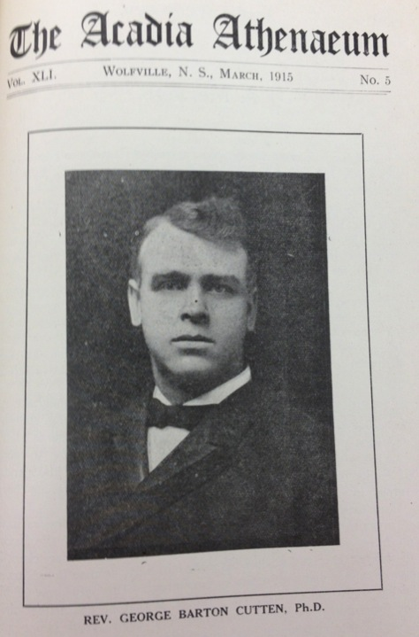
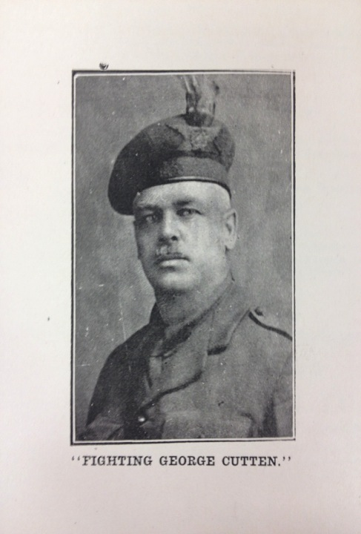
Notes:
March 1915: The Athenaeum demonstrates that Acadia students had a profound sense of respect for President George Barton Cutten. Students used the newspaper to discuss Cutten’s initiatives to garner support for the war. In a June 1916 issue of the Athenaeum, the president is dubbed “Fighting George Cutten” in homage to his recruitment efforts. A picture of him in his military uniform is included. Furthermore a November 1917 issue reproduces the lyrics to “Cutten’s Song,” known formally as “The Son of God Goes Forth to War.” Cutten’s collection of war posters still exists today in the Esther Clark Wright Archives. Moreover, many of the back issues of the Athenaeum from the war years were Cutten’s personal copies.

Slide 13
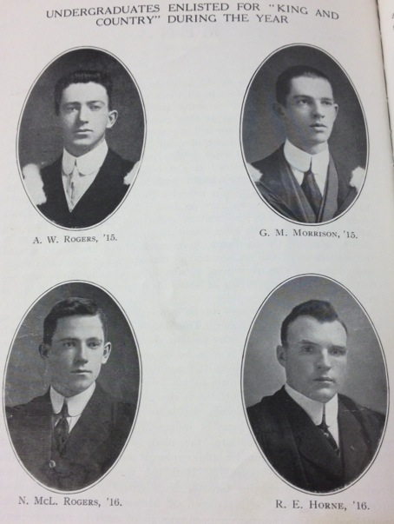
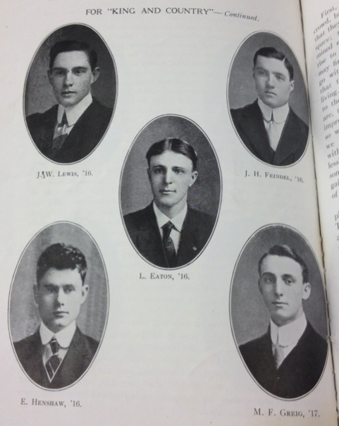
Enlisted for “King and Country”, May 1915
Notes:
May 1915: In this issue of the Athenaeum, the names and photographs of those who had recently enlisted to fight overseas were published. The jovial tone of this article is a far cry from the somber stories that would appear as the war progressed.

Slide 14
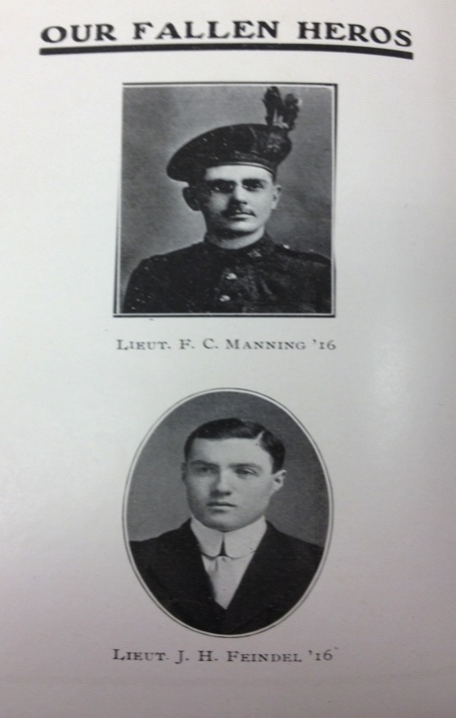
Notes:
1917: Some of the same faces would turn up in the obituary section of the Athenaeum. It is a dismal commentary on the loss of life that was so common throughout the First World War.

Slide 15
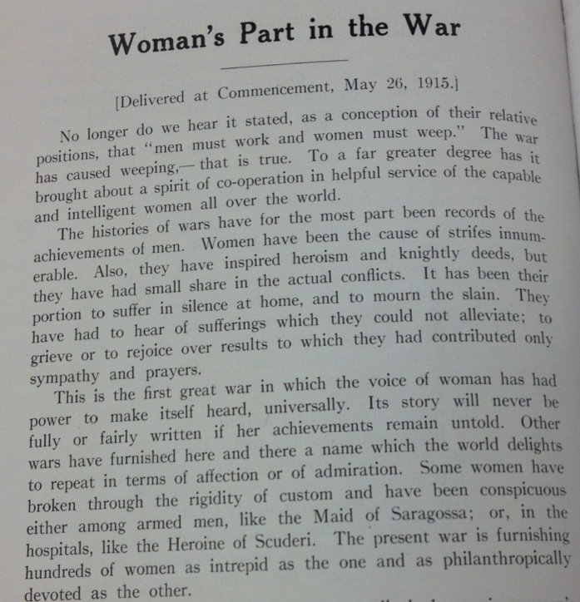
Notes:
May 1915: The Athenaeum reflects the fluidity of gender roles during the First World War. This article is a reproduced version of a speech given at commencement in 1915. The author explains how “this is the first great war in which the voice of woman has had power to make itself heard, universally.” For example, women began to work industrial jobs while men fought overseas. It would not be long before women would obtain suffrage. Perhaps the most impressive accomplishment for Acadia women during WWI was the first female editor of the Athenauem in 1917.

Slide 16
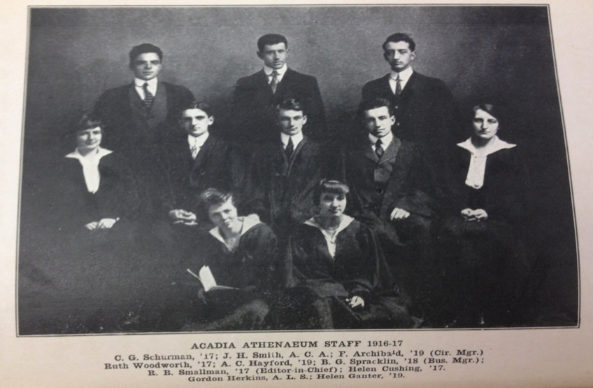
Athenaeum Staff – 1916-1917
Notes:
4 women

Slide 17
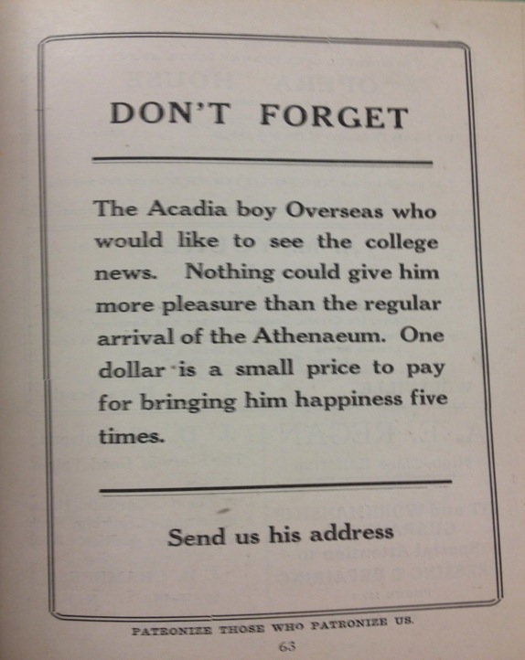
Notes:
1918: Towards the end of the war, the Athenaeum initiated this campaign to send issues to Acadia students on the front. If one’s relative or friend were stationed overseas, they had the opportunity to pay for copies of the newspaper to be shipped to the front.

Slide 18
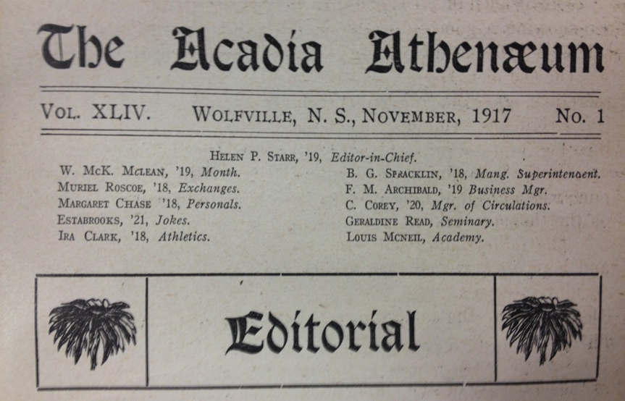

Slide 19
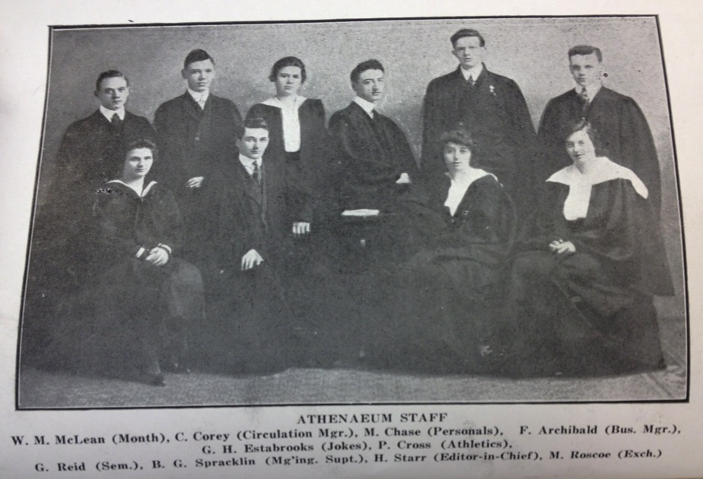
Athenaeum Staff - 1917-1918

Slide 20
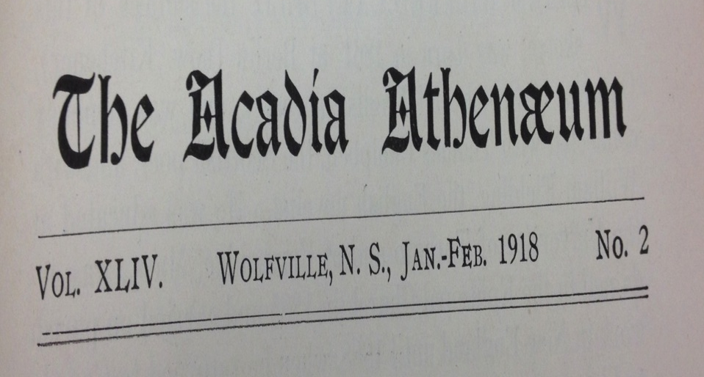
Fostering a Wartime Campus Discourse

